Slide 1
Impact of British education on Indian society

Slide 2
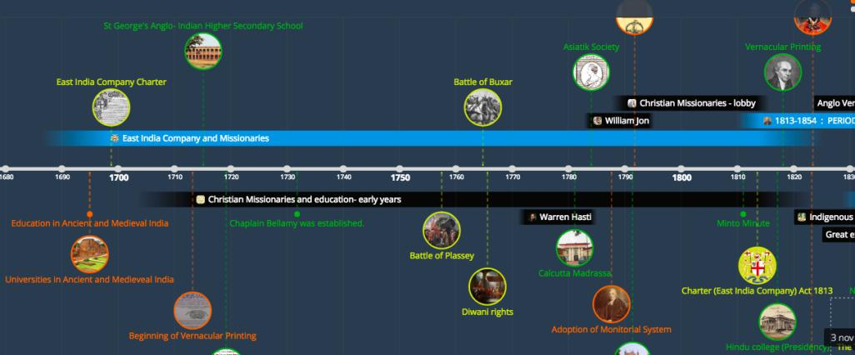
TIMELINE OF EDUCATION IN COLONIAL INDIA
TIMELINE- https://time.graphics/line/2337
Notes:
Class of HS 511- 2017

Slide 3
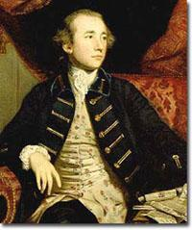
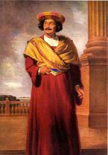
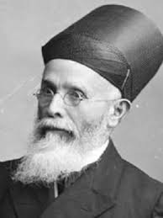
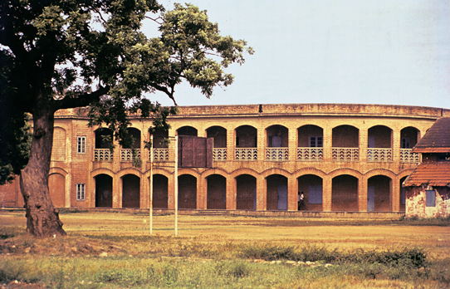
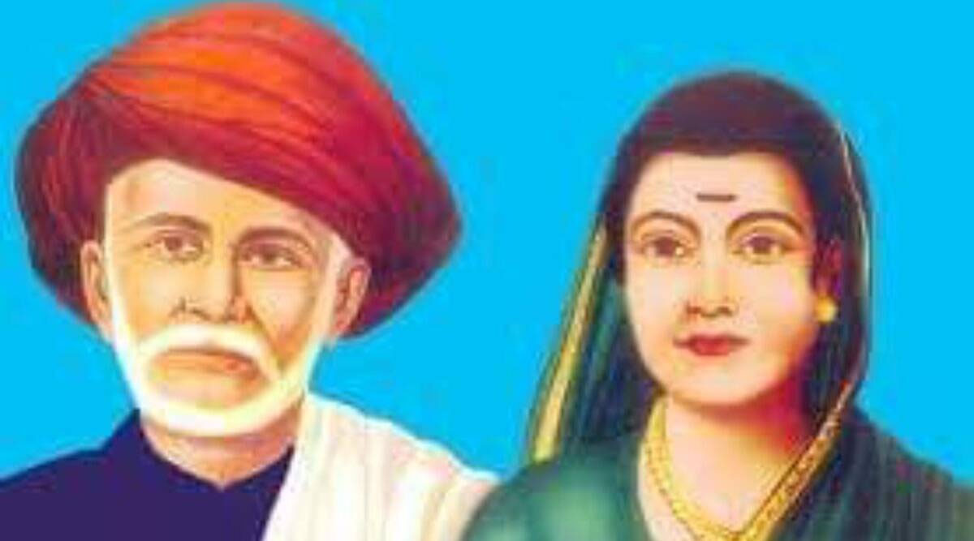

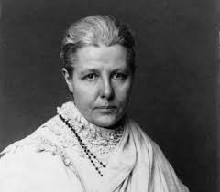
Effects of the WESTERN Education in BRITISH India
Impact on Literature, Society, Religion, and Politics
https://time.graphics/line/2337
Notes:
Introduction to the New Education System
Objective: Spread Western literature and science through English
Impact: First exposure of Indian intellect to Western thought, leading to a modern renaissance.
Key Reform: Wood’s Despatch (1854), which formalized this education system.

Slide 4
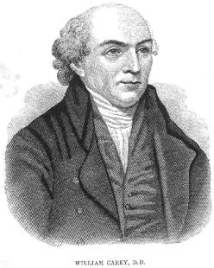
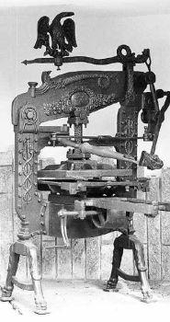
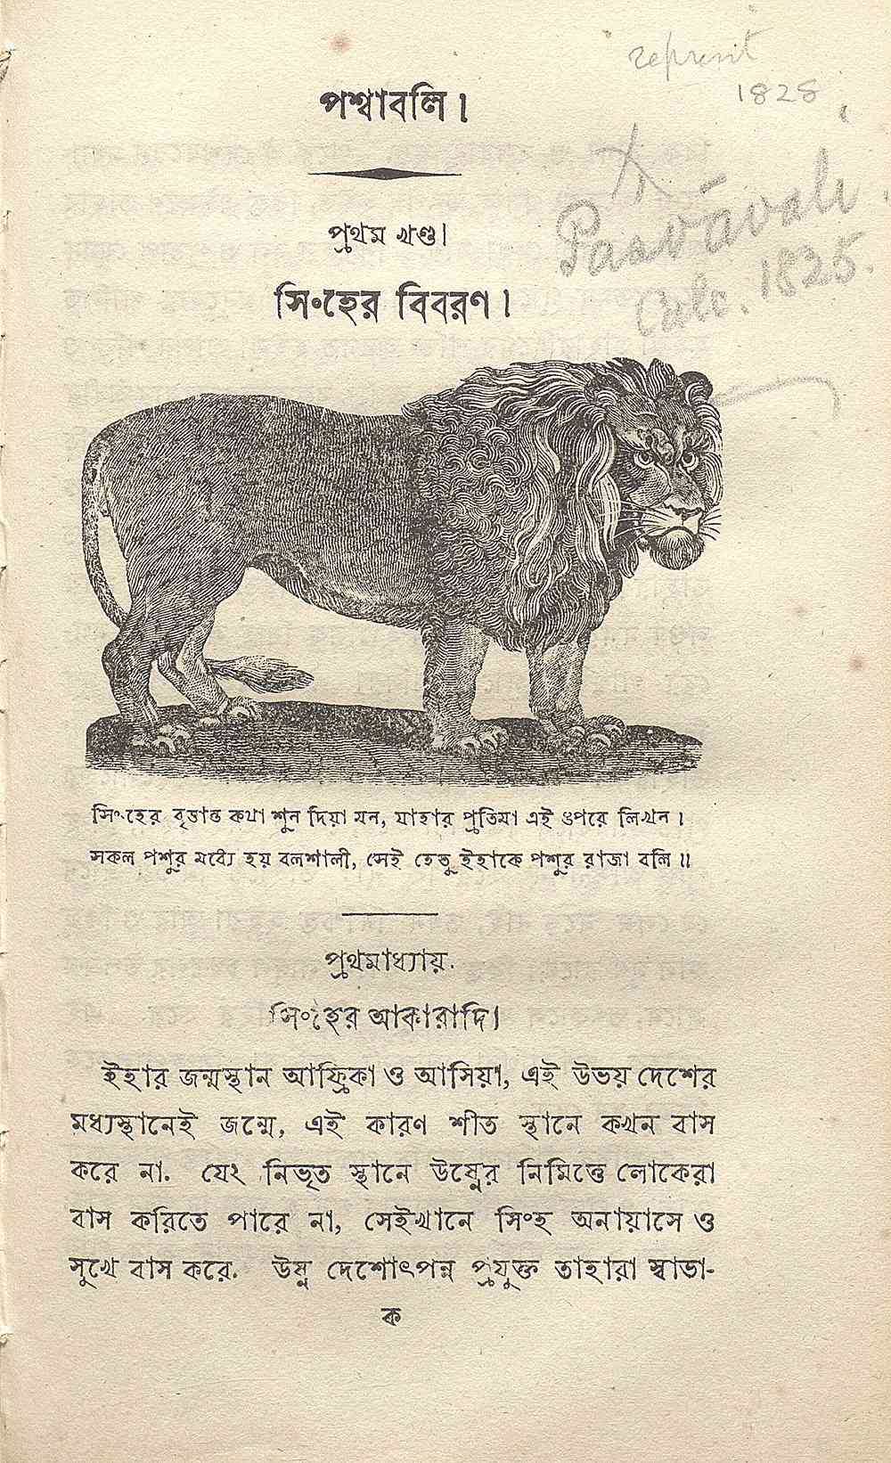
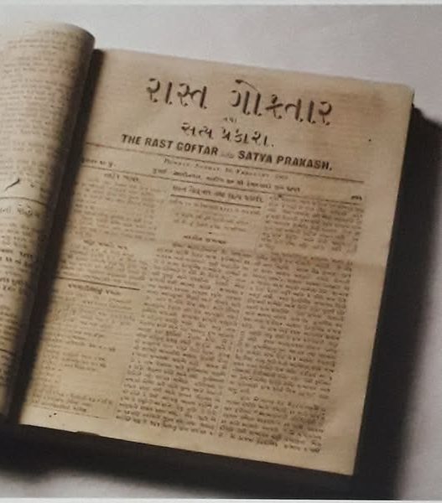
Growth of Literature and Press
Missionaries' Role: Started the first printing press and newspapers.
Company & Government's Role: Publishing of books in Indian languages.
Private Enterprise: Educated Indians formed societies to publish books and newspapers.
Development of modern Indian literature and a growing press.
https://scroll.in/article/1003081/how-an-1822-publication-by-the-calcutta-school-book-society-brought-animal-biographies-to-students
Notes:
One of the most profound impacts of the new education system in colonial India was the emergence of a vibrant literary and press culture in modern Indian languages. Initially, this effort was spearheaded by Christian missionaries who sought to translate the Bible into Indian languages and create linguistic aids such as dictionaries and grammars. While their primary goal was religious, their contributions laid the foundation for the development of vernacular literature. Alongside them, the British East India Company and later the colonial administration played a crucial role in formalizing educational structures and sponsoring the publication of secular books. The earliest books under this system were largely translations of well-known English works or instructional materials in subjects like history, algebra, and science, aligned with the curriculum of the new schools. These efforts gradually introduced a wider Indian readership to Western ideas and scientific thought, fostering intellectual curiosity and social awareness.
By the late 19th century, educated Indians took the initiative to further develop literature in their native languages. Inspired by their exposure to English literature, they established literary societies, wrote original works, and launched newspapers aimed at disseminating knowledge and advocating for social reform. Newspapers such as The Hindu, Kesari, Amrita Bazar Patrika, and Bengalee became powerful platforms for discussing social injustices, economic exploitation, and political grievances against British rule. This press revolution not only created a sense of solidarity among educated Indians but also contributed to a growing nationalist consciousness. By 1902, most major Indian languages had developed a substantial body of modern literature, and the Indian press had become a formidable force in shaping public opinion, setting the stage for future movements for independence.

Slide 5
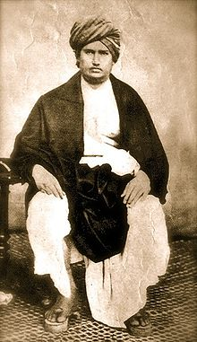
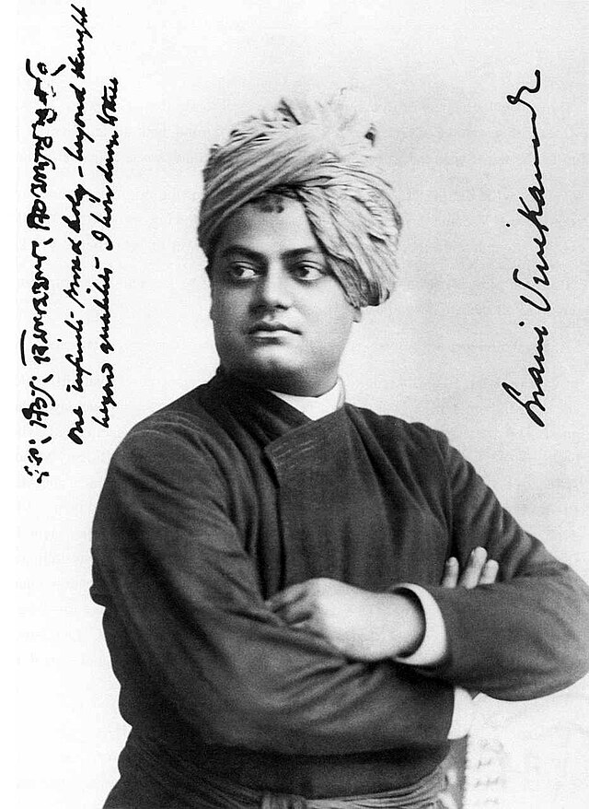
Social and Religious Reforms
Strengthened movements for caste reform, widow remarriage, and the abolition of untouchability.
Key Reform Movements: Brahmo Samaj (Raja Ram Mohan Roy), Arya Samaj (Swami Dayanand Saraswati) Ramakrishna Mission (Swami Vivekananda)
Step towards modernization of Hindu society and rejection of orthodox traditions.

Slide 6
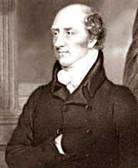
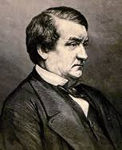
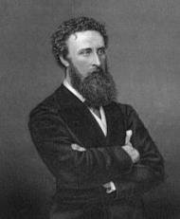
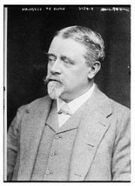
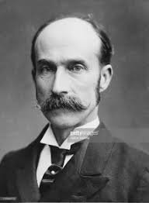
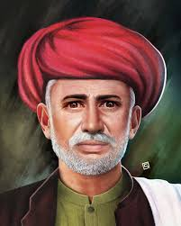
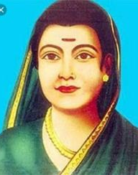
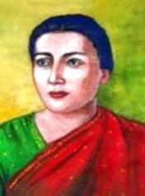
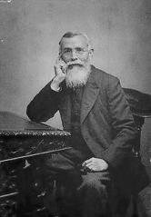
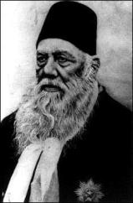
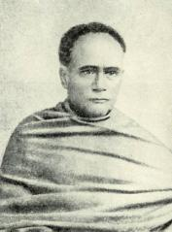
Lord Mayo
1869-72
Lord Lytton
1876-1880
Lord Ripon
1880-1884
Lord Lansdowne
1888-1894
Lord Canning
1858-63
Viceroys of India In Victorian Period
Jyotirao Phule
Tarabhai Shinde
Dadabhai Naoroji
Sayyed Ahmed
Khan
Ishwar Chandra
Vidyasagar
Savitribai Phule
MAKERS OF MODERN INDIA IN VICTORIAN PERIOD
Notes:
https://byjus.com/free-ias-prep/list-viceroys-india/

Slide 7
Impact on Political Awakening
Early Focus on Social Reforms: Educated Indians, mostly government servants, engaged in social reform rather than politics.
Shift to Political Awareness: Growing discontent with British policies. Awareness of economic exploitation and lack of political rights.
Birth of Political Consciousness: Led to the formation of the Indian National Congress (1885).

Slide 8
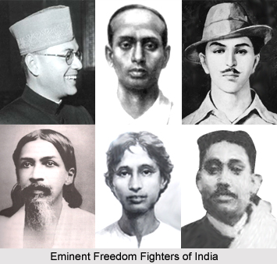
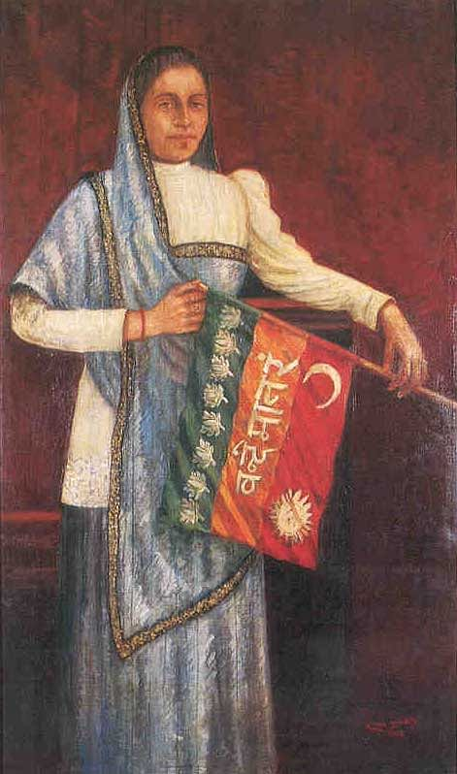
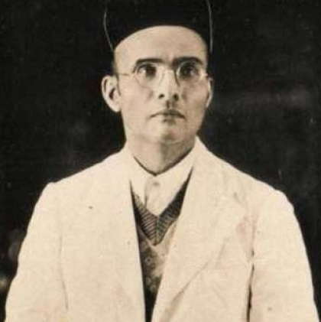
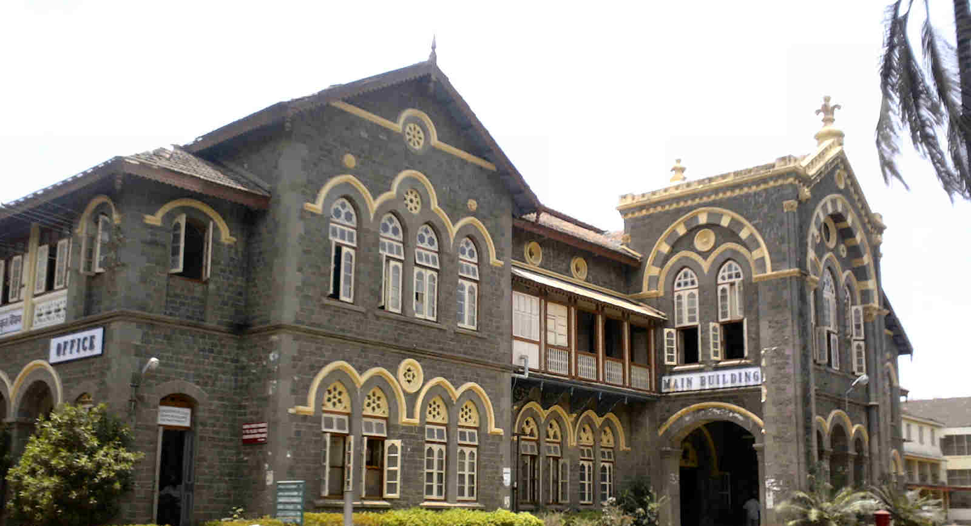
-
Bhikaji Rustom Cama
Notes:
More than a century ago, on 21 August 1907, the Indian flag was hoisted for the first time on foreign soil in Stuttgart, Germany. When the Union Jack was about to be hoisted at the International Socialist Conference as the national flag of India, Bhikaji Rustom Cama opposed it. She took out a small Tricolour from her bag.
The flag, which came to be called the Berlin Committee Flag, was designed by Cama, Shyamji Krishna Verma and Vinayak Damodar Savarkar. It was an early precursor to the tricolour India eventually adopted in 1947.
Bhikaji Cama devoted her life to philanthropy and social work. She not only fought for human rights and autonomy from British rule, but was also a champion of women’s rights and suffrage. The Russians used to call her the ‘Indian Joan of Arc,’ while Indians dubbed her ‘Mother of the Revolution.’
“When India is independent, women will not only have the right to vote but all other rights,” was her stance. Cama believed equality for women and freedom from British rule were the same thing. The daughter of affluent Parsi trader Sorabji Framji Patel, Madame Cama was born in Bombay on 24 September 1861 and completed her education at Alexandra Girl Education Institute.

Slide 9
Role of Western Thought in Nationalism
Influence of English History: Inspired ideas of democracy and self-rule.
Educated Class’s Perspective:
Recognized Britain’s contributions but also saw its exploitative nature.
Advocated for self-rule rather than just good governance.
Education as a Tool for Resistance: Helped organize movements against colonial rule.

Slide 10
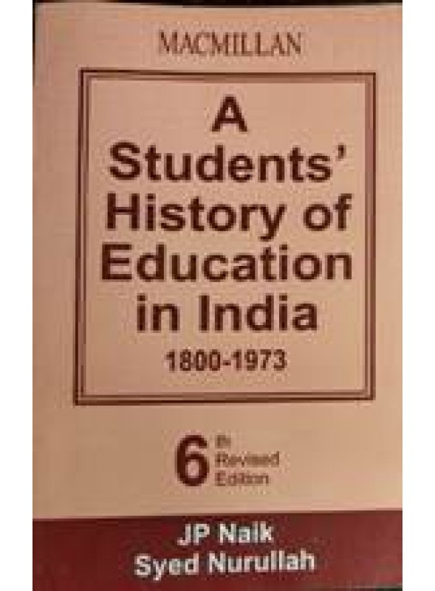
Role of Western Thought in Nationalism
Influence of English History: Inspired ideas of democracy and self-rule.
Educated Class’s Perspective:
Recognized Britain’s contributions but also saw its exploitative nature.
Advocated for self-rule rather than just good governance.
Education as a Tool for Resistance: Helped organize movements against colonial rule.

Slide 11
Changing Western Attitudes Towards Indian Knowledge
Early Views (Pre-1854): British saw Indian philosophy and literature as inferior.
Post-1854 Shift:
Translations of Indian texts (Upanishads, Vedas).
European scholars like Max Müller popularized Sanskrit literature.
Indian universities promoted the study of classical languages.
Result: Greater appreciation and synthesis of Eastern and Western knowledge.

Slide 12
Cultural Synthesis & Identity Crisis
Early Effects: Imitation of Western manners, clothing, and even food habits.
Shift to Cultural Synthesis:
Emergence of a National Identity: Led by figures like Vidyasagar, Naoroji, Vivekananda.
New Outlook: Acceptance of useful Western ideas while preserving Indian traditions.
Result: A more balanced, modernized Indian intellectual class.

Slide 13
Education in India During the British Period
Achievements, Failures, and Legacy
Notes:
Include an image of a colonial-era classroom or a British educational institution in India

Slide 14
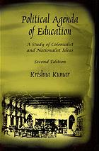
How did British rule shape Indian education?
Two Contrasting Views:
British claimed they modernized education.
Indians argued it was politically motivated and inadequate.
Need a balanced, critical evaluation.

Slide 15
Contributions of British Education Policies
Despite its failures, British education brought: Introduction of English literature & science to India.
Scientific study of Indian culture (e.g., Sanskrit, historical texts).
Development of modern Indian languages (missionary work, dictionaries).
Preservation of art & heritage (Curzon’s conservation efforts).

Slide 16
British View of India’s Role
Colonial Perspective on India:
Seen as a market for British goods, not as a developing nation.
Missionaries saw India as a conversion ground.
British industries benefited, but Indian development was ignored.
Education policies focused on serving British needs, not Indian aspirations.

Slide 17
British Failure to Create a National Education System
British Failure to Create a National Education System
Education remained fragmented:
Transferred to Indian control in 1921, but no solid framework existed.
The 1944 Post-War Education Plan came too late.
A delayed and inconsistent educational structure.

Slide 18
Influence on Social & Political Reforms
Western education led to: Rise of social movements (abolition of untouchability, women’s rights).
Political awareness → Seeds of Indian Nationalism.
Introduction to democratic institutions & modern governance. Legacy: Inspired leaders like Gandhi, Nehru, and Ambedkar.

Slide 19
Limitations of the New Education System
Economic Neglect: Education did not promote industrial or vocational skills.
Lack of technical and Vocational education (Gandhi’s lament and Nai Talim)
Limited Reach: Only a small elite received education.
Class & Caste Divide:
Benefited urban, upper-caste elites.
Rural and lower-caste masses remained largely uneducated.
Gap between those who “work with mind” (white collar, babu) and “work with hand” (blue collar)
Enduring Impact: Social divide in education still persists today.

Slide 20
Key Policy Mistakes & Their Effects
Neglect of Indigenous Education: Led to its decline. English-Centric Model: Ignored regional languages.
Downward Filtration Theory: Kept education restricted to the elite. Created social and economic divides in access to education.

Slide 21
Lack of East-West Educational Synthesis
Failure to integrate Western and Indian knowledge.
British officials: Many dismissed Indian culture as inferior.
Lost opportunity to create a blended education model.

Slide 22
Legacy
Transformation in Indian Society: Education fostered literature, press, social reforms, and nationalism.
Seeds of the Independence Movement: Awareness of colonial exploitation led to organized resistance.
Continuing Relevance: Challenges of access and equity in education persist in India even today.
Education system was a paradox—while it empowered Indians intellectually, it also reinforced social inequalities.

Slide 23
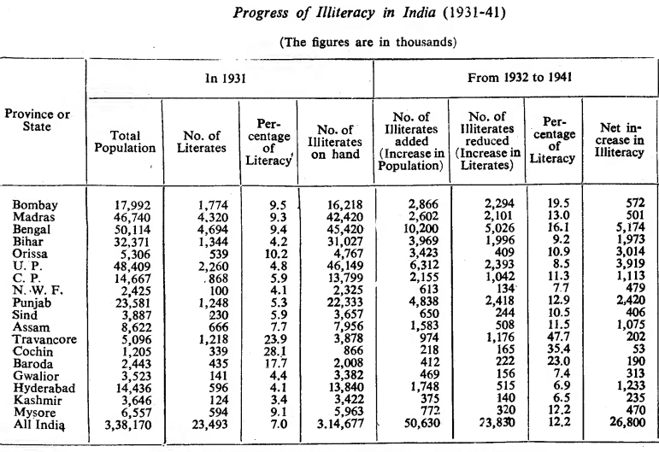
Regional variations
Nurullah
and Naik

Slide 24
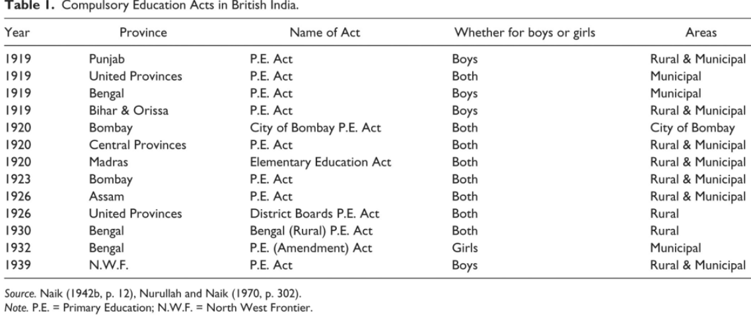
COMPULSORY EDUCATION ACTS

Slide 25
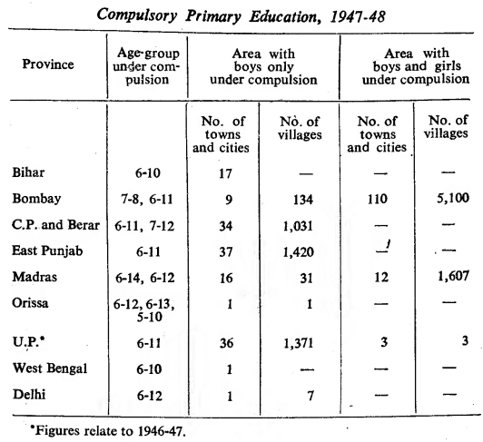
Progress in Compulsory education: 1937-45
If these statistics are compared with those of 1936-37, it will be noticed that the best progress was made in Bombay where compulsion was introduced in several municipal areas and in all villages with a population of 1,000 or more. .
In other parts of India, the progress can only be called poor. When it is remembered that the nation was irrevocably committed to the introduction of compulsory education for boys and girls in the age group of 6 to 14 before 1960-61, it becomes at once evident that the progress of compulsory education in the past, if it can be called progress at all, was extremely disappointing
Nurullah and Naik

Slide 26
State of Education at India’s Independence
Population in 1947 : around 406 million (India + Pakistan combined)
Elementary Education:
Elementary schools: 1.72 lakhs (decline from 1.89 lakhs in 1936-37)
Number of pupils : 1.3 crore (increase from 1.05 crore in 1937)
Expenditure: 15.5 crores
Secondary Education:
Number of schools: 17,250 (Increase from 13,400 in 1936-37)
Number of Pupils: 36.06 lakhs (Increase from 23.93 lakhs in 1936-37)
Expenditure: 17.9 crores
Higher Education:
15 Universities, 16,000 students , expenditure – 2.03 crores
300 Arts and Science Colleges, Pupils: 96,000 , expenditure- 3.53 crores
16 engineering and technical colleges, 72,000 students; expenditure – 2.73 crores
S C Ghosh

Slide 27
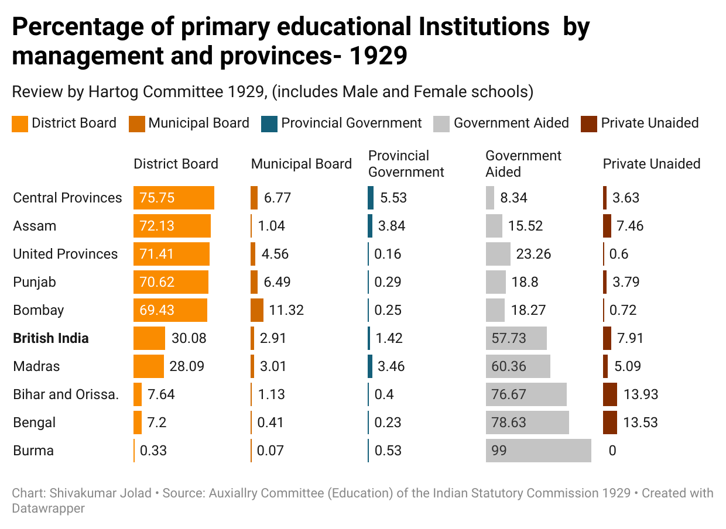
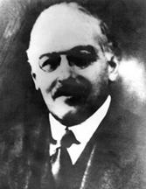
Schools in Colonial India -1929
LOCAL
STATE
v
v
Philip Hartog

Slide 28
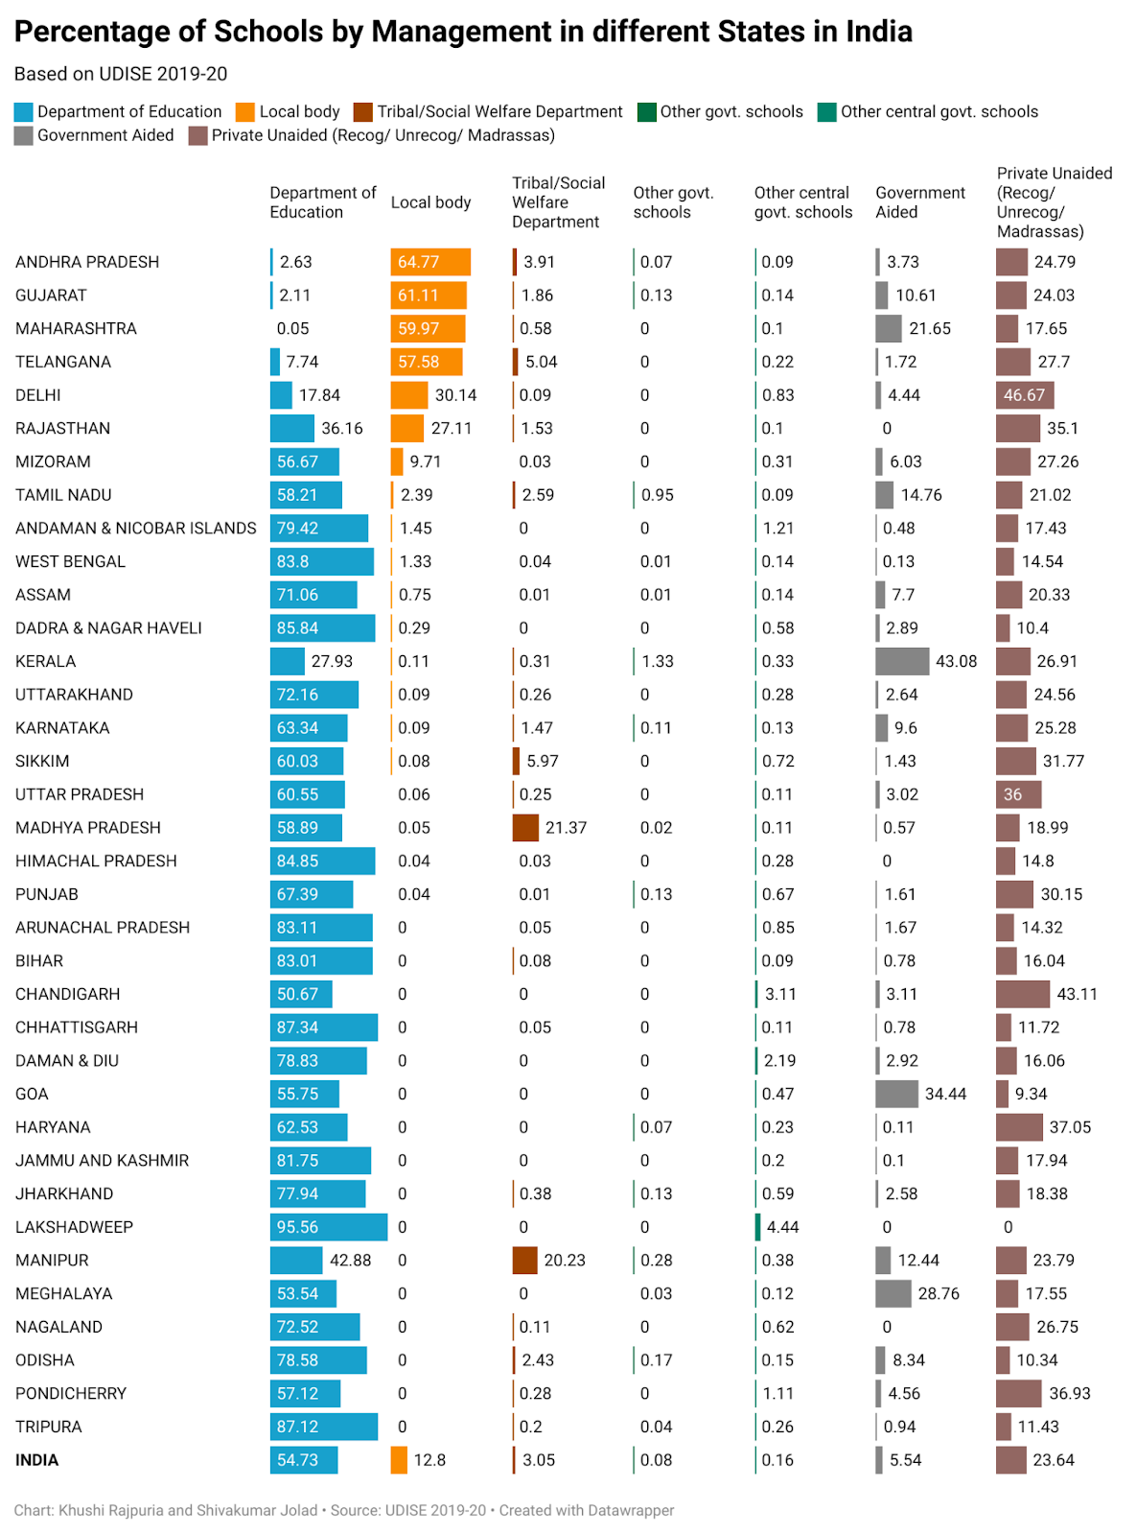
STATE
LOCAL
CENTER
v
v
v
UDISE [Dataset] (2020) Department of School Education, Ministry of Education, Government of India <https://dashboard.udiseplus.gov.in/#/reportDashboard/sReport>
Notes:
There have been many debates how schools are best governed at the local level for various reasons.
Analysis of UDISE data shows that at all Indian levels, 77% of government schools are managed by the Department of Education, while only 18% of schools are controlled by local bodies.
Even in states with many local body schools, school funding, teacher appointment, and teacher transfer are controlled by the state.

Slide 29
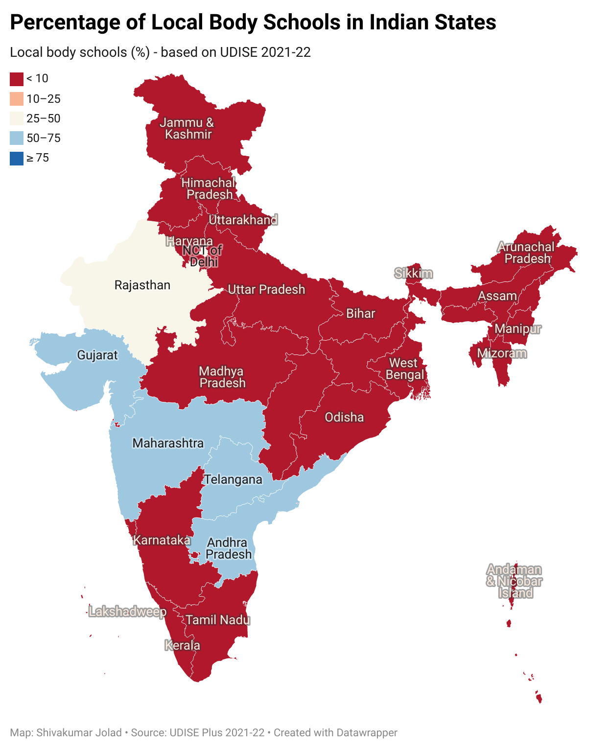

Slide 30
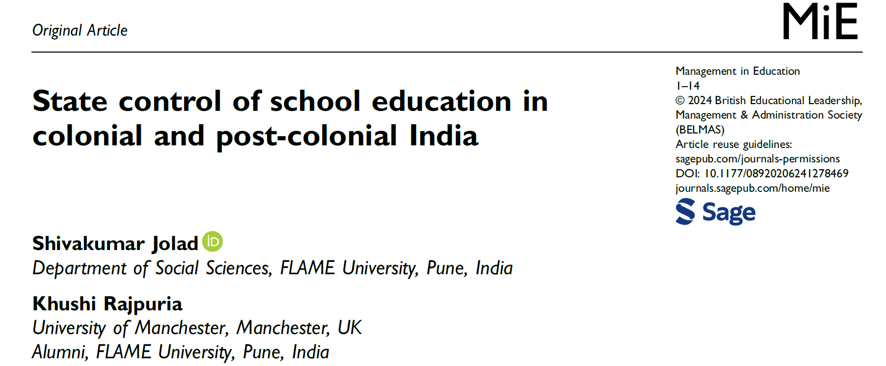

Slide 31
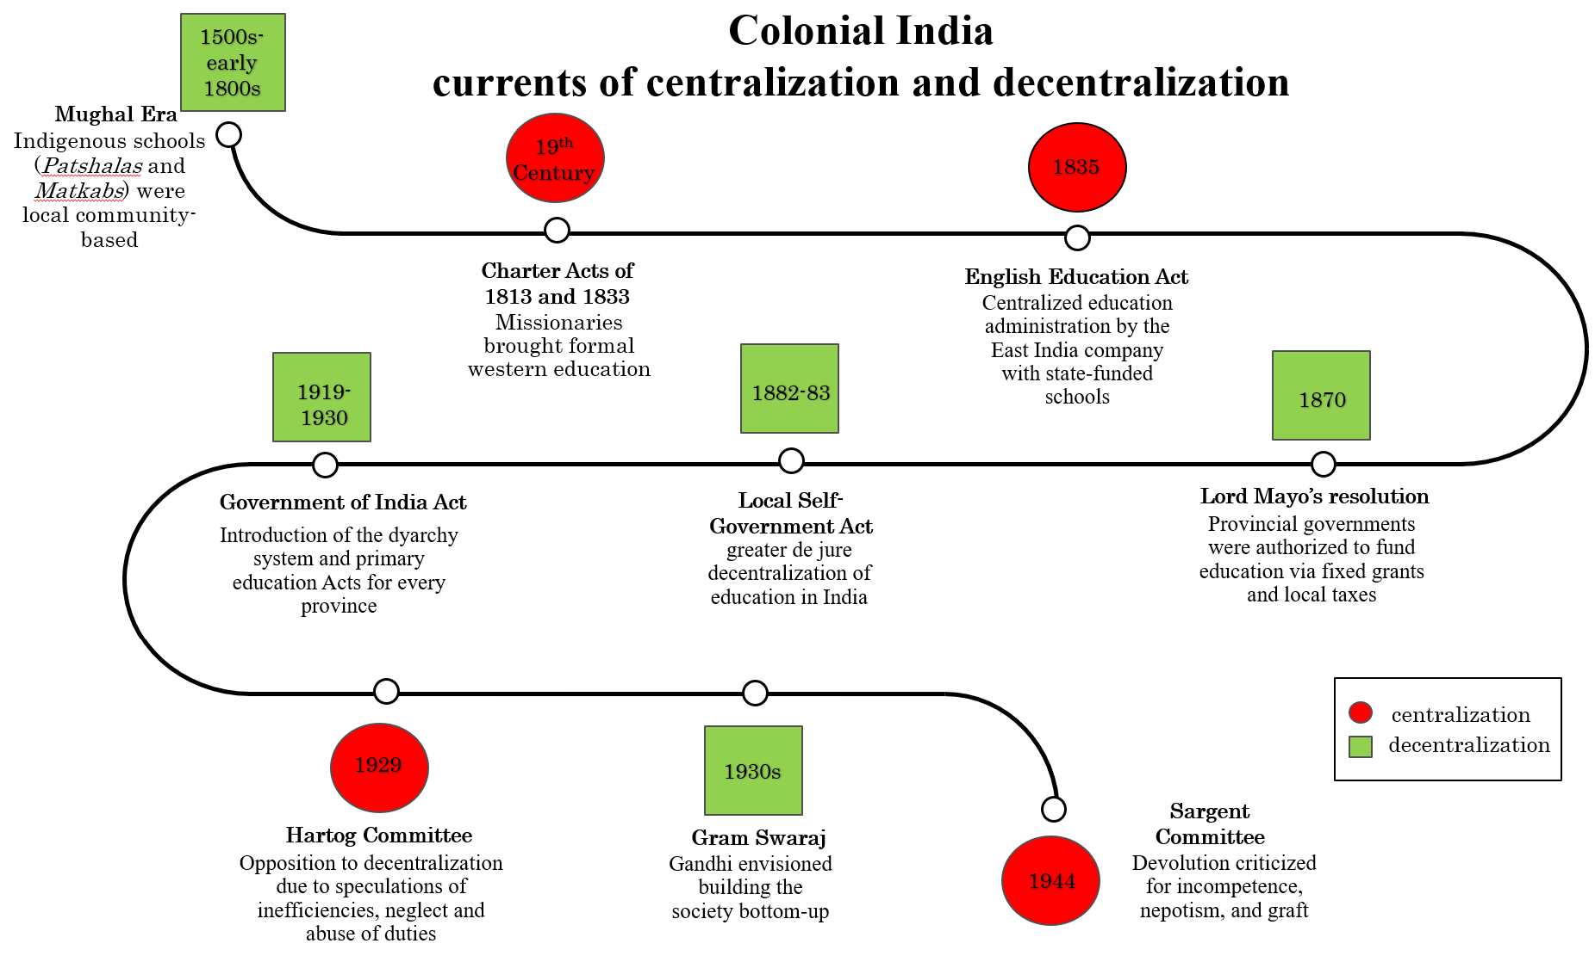

Slide 32
STATE EDUCATION ACTS
Maharashtra and Gujarat (which were part of Bombay in 1947-1960) followed a different trajectory. The Bombay Primary Education Act- 1947 (later amended and renamed as Maharashtra Primary Education Act) entrusted the District school boards, Municipalities, and Municipal school boards with powers to establish and manage.
Andhra Pradesh : The Andhra Pradesh Primary Education Act- 1982, vested the power to ensure free and compulsory education to local authorities- (municipal corporation/muncipal council, Zillla Praja Parishad, Mandala Praja Parishad).
Karnataka: Karnataka Education Act- 1983 gave sweeping powers to the state to regulate general education including the establishment and recognition of schools, the appointment of teachers in government schools. The state to take over the management, of educational institutions, including local authority schools and private schools, all in “public interest”
Uttar Pradesh: the Basic Education Act of 1972, brought all the local body and/or zilla parishad schools under the state government's direct control, teacher appointment became more centralized, and their salaries were paid by the state government directly
v
v
Notes:
Maharashtra and Gujarat (which were part of Bombay in 1947-1960) followed a different trajectory. The Bombay Primary Education Act- 1947 (later amended and renamed as Maharashtra Primary Education Act) entrusted the District school boards, Municipalities, and Municipal school boards with powers to establish and manage (provide infrastructure, teaching aids etc) the schools within their jurisdiction. There was even power to take over all teachers employed before under the board's control. (Bombay Primary Education Act- 1947, 1947; The Maharashtra Primary Education Act (Bombay Act No, LXI of 1947), 1947). These district school boards

Slide 33
Post-colonial India
currents of centralization and decentralization
1950
Constitution of India
A highly centralised two-tier Federal system was adopted
1951-54
1966
1970-
1990
Kher Committee Report
Kothari Commission
State Education Acts
Kher Committee Report
Local administration caused teacher harassment. Safeguards were recommended.
Advocated for a greater role of state governments in education governance
Took control of Education
from local bodies. Controls funds and functionaries
1992
1992-93
1984
NPE & PoA
73rd and 74th constitutional amendments
Planning Commission
envisaged district and village-level bodies to plan, implement and administer educational programmes
Recommended a multi-level planning framework with districts being treated as sub-states
Mandated decentralization-criticized for being unsuccessful as PRIs lacked the resources carry out their duties
2001
2009
Sarva Shiksha Abhiyan, Central schemes
RTE Act
Assigns duties to local governments without empowering them. There is limited fiscal transfer
Funding for Education from Centre- also controls education ; District level Planning Village Edu Committees
National Education Policy
Silent about PRIs, urban local bodies or educational decentralization
centralization
decentralization
2020
mixed

